Slide 1
Purposeful Culture
DELIVERING ACTIONABLE TALENT INTELLIGENCE

Slide 2
Agenda
What is culture and why is it so important
Leadership’s impact on corporate culture
Culture Case Studies
6 signs your culture is a liability
Data driven approach to monitoring culture

Slide 3
What is culture?

Slide 4
The culture you create has impact wide-ranging impact
Cultural studies have shown that the right culture has huge impacts on:
Performance
Morale
Job satisfaction
Employee engagement and loyalty
Employee attitudes and motivations
Turnover
Commitment to organization
Attraction & retention of employees

Slide 5
Culture Risk Factors

Slide 6
Culture impact on firm performance
Companies with healthy culture
Sales = 682% increase
Stock increases = 901% increase
Companies with unhealthy culture
Sales = 166% increase
Stock increases = 74% increase
D.D. Warrick – What Leaders Need to Know About Organizational Culture

Slide 7
Leadership and the Culture Box
Culture Box
Leadership Traits and Skills
Leader
Behaviors
Influence
Processes
Follower Attitudes and Behaviors
Performance Outcomes
Situational
Factors
Gary Yukl – Leadership in Organizations

Slide 8
Culture Case Studies

Slide 9
Poor Leadership Drives Poor Culture
$555M (USD) deal in 2014
Merger looked to take advantage of emerging market for internet-connected smart devices in home
Nest culture like Apple culture – hierarchical leadership structure, meeting culture, and culture of micromanagement
Nest CEO Tony Fadell admits that about 50% of Dropcam employees have left. States “A lot of the employees were not as good as we hoped…unfortunately it wasn’t a very experienced team.”
Dropcam CEO Greg Duffy left a few short months later. In hindsight, regretted deal.
Nest revenue has not kept pace with investment by Alphabet.
Tony Fadell moved into a new role at Alphabet in June 2016.

Slide 10
Senior Leadership Adapting to New Cultures
$3.3B (USD) deal in 2016
Jet.com in office Thursday happy hour stopped by Wal-Mart and moved to local bar
Poor attendance by Jet.com team off premise
Wal-Mart CEO Doug McMillon asks if Jet.com CEO Marc Lore if Wal-Mart “hugging” too tightly
Lore shares concern about poor attendance
Wal-Mart shifts course and allows in office happy hour again

Slide 11
6 Cultural Risks

Slide 12
6 Signs of Cultural Risk
Risk #1 - Inadequate investment in people
Risk #2 - Lack of accountability
Risk #3 - Lack of diversity, equity and inclusion
Risk #4 - Poor behavior at the top
Risk #5 - High-pressure environments
Risk #6 - Unclear ethical standards
Sarah Clayton – 6 Signs Your Corporate Culture is a Liability (HBR December 5, 2019)

Slide 13
Data-driven approach to monitoring your culture

Slide 14
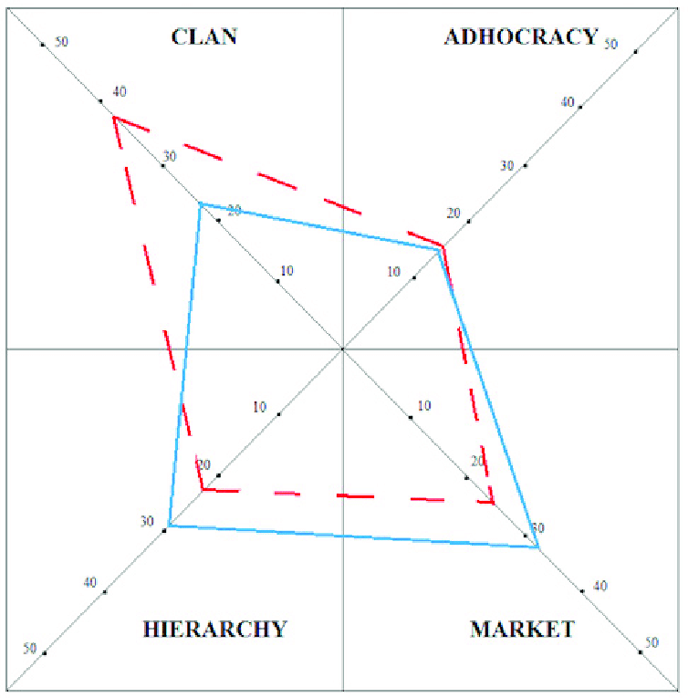
Measuring Culture - OCAI
Gives a broad indication of what your culture is today and what your team wants the culture to be in the future

Slide 15
ASSESSMENTS COMPRISING THE TEAM REPORT
HOGAN PERSONALITY INVENTORY (HPI)
HOGAN DEVELOPMENT SURVEY (HDS)
MOTIVES, VALUES, PREFERENCES INVENTORY (MVPI)
The Bright Side
Assesses normal personality as it relates to success in a job or career
The Dark Side
Assesses 11 patterns of behaviors that can lead to career derailment
The Inside
Assesses core values related to organization and career fit and to the culture created by the leader

Slide 16
TEAM CULTURE
 | Recognition | Responsive to attention, approval, praise, and recognition
 | Power | Desires success, accomplishment, status, and competition
 | Hedonism | Motivated by fun, pleasure, and good company
 | Altruistic | Concerned for the less fortunate and improving society
 | Affiliation | Enjoys frequent and varied social interaction
 | Tradition | Dedicated to established procedures and conservative values
 | Security | Desires certainty, predictability, order, and control in their lives
 | Commerce | Interested in financial and business-related matters and money
 | Aesthetics | Interested in culture, good taste, and attractive surroundings
 | Science | Desires knowledge and the pursuit of data
Status
Social
Financial
Decisions

Slide 17
Customer Team Profile
Executive Team
HiPo Leadership Program

Slide 18
Leadership Development Program Profile

Slide 19
Recommendations
Be Purposeful - Know where your culture is as a routine and where you want it to be in the future. Understand the gap. Plan to close gap.
Continuously Reinforce – At every opportunity to engage with your team, reinforce the culture you want whether 1-on-1 or 1-on-many
Monitor you and your leadership team – You and your leadership team are major drivers of corporate culture. If the leadership team is out of alignment it will affect the culture you seek
D.D. Warrick – What Leaders Need to Know About Organizational Culture

